Slide 1
HEALTHCARE ANALYTICS
Application of Convolutional Neural Networks and Vision Transformers for the Multi-Class Classification of Infectious Respiratory Diseases from Chest Radiological Images
Submitted by:
· Bhumika Raut - 23070521221
· Anushka Gahukar - 23070521192
Section: ‘C’
Symbiosis Institute of Technology, Nagpur

Slide 2
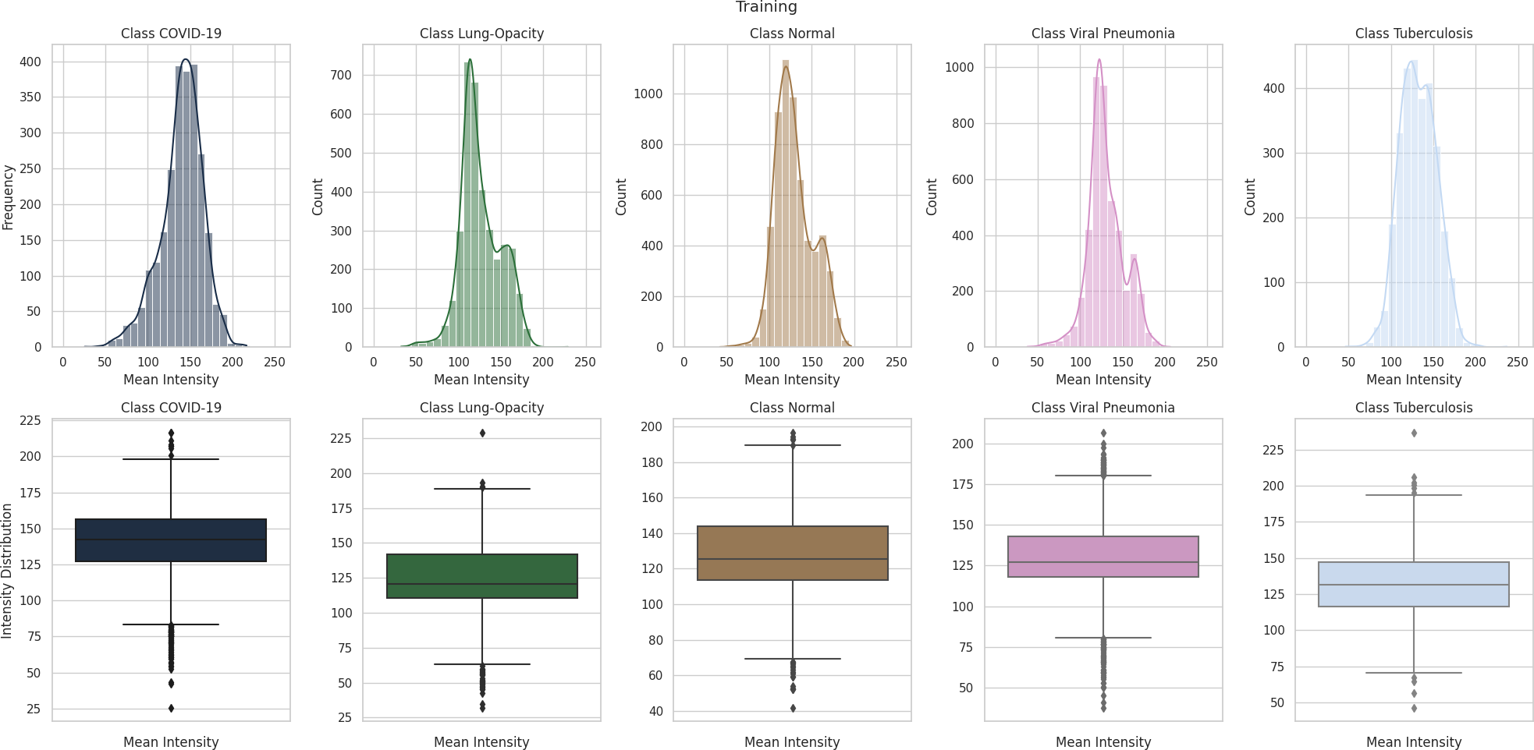
Problem Statement
What problem are we solving?
How reliably can CNN and Vision Transformer models classify chest radiographs into five classes despite overlapping appearance, class imbalance and image-source variability?
Overlapping characteristics
Dataset imbalance
Image variability
Lung Opacity and Normal are the main confusion; intensity distributions overlap across classes
10,192 Normal vs 4,189 COVID-19 images (≈2.4 : 1)
Images pooled from several sources and equipment, with artefacts
Mean-intensity distributions per class (EDA, source figure) — overlapping ranges.
Investigates: which architecture family handles this best, and what do explainability methods reveal?
2 / 13

Slide 3
Dataset
32,687 frontal chest radiographs · five classes
COVID-19
4,189
32,687
total images
Lung Opacity
6,012
6,540
Normal
10,192
fixed test split
Viral Pneumonia
7,397
≈ 2.4 : 1
Tuberculosis
4,897
Normal vs COVID-19 imbalance
Bars proportional to image counts (axis starts at 0)
Source: Qatar University & University of Dhaka (released 25 Sep 2021): COVID-19 Radiography Database plus Tuberculosis images; frontal views only. Imbalance is handled with class-weighted loss.
3 / 13

Slide 4
Existing Solutions
Established approaches, strengths and limitations
Approach | Strength | Limitation
Conventional radiograph reading | Low cost, widely available | Observer variability; overlapping 2-D anatomy
Traditional CNN classification | Learns local image features automatically | Needs much data; may exploit shortcuts [4]
Transfer learning (VGG, ResNet) | Pretrained features; faster convergence | Source-domain mismatch; large models
Attention & Vision Transformers | Focus on relevant regions / global context [9], [13] | Data-hungry; weaker when trained from scratch
THIS PROJECT
Implements each family under one fixed split and preprocessing: Baseline CNN, VGG19 and ResNet50 (transfer learning), a Custom Spatial-Attention CNN and a from-scratch ViT.
4 / 13

Slide 5
Proposed Solution
A five-class classification system with an upload-to-report workflow
1
2
3
4
Preprocess
Compare five models
Handle imbalance
Website
Zoom, CLAHE, sharpening, rescaling, zero-centring
Baseline CNN · VGG19 · ResNet50 · Custom CNN · ViT
Class-weighted loss on 5 classes
Upload X-ray → model prediction → PDF report
Decision-support concept — not a replacement for clinicians, and not clinically validated.
5 / 13

Slide 6
Methodology
Pipeline, preprocessing parameters and training strategy
1
2
3
4
5
6
7
8
Dataset
Exploratory
Data Analysis
Image
Preprocessing
Dataset
Preparation
Model
Training
Performance
Evaluation
Explainability
Analysis
Classification
Output
PREPROCESSING PARAMETERS
TRAINING STRATEGY
Zoom
0.83
Baseline CNN · VGG19 · ResNet50 · Custom CNN · ViT
CLAHE clip limit
2
Same fixed split (test set 6,540) for all models
CLAHE grid size
15
Class-weighted loss to address imbalance
Sharpening kernel
centre 5, four neighbours −1
VGG19 / ResNet50: two-stage fine-tuning
Then
rescaling · zero-centering
6 / 13

Slide 7
Models and Tools Used
Five architectures on a Python deep-learning stack
TOOLS
Python 3
TensorFlow / Keras
OpenCV
Baseline CNN
VGG19
ResNet50
Custom CNN
ViT
104.0 M
38.9 M
23.6 M
2.54 M
89.7 M
NumPy · Pandas
Conv stack
Pretrained
Pretrained · skip
Attention gate · DS-conv · skip
Patches · self-attention
Matplotlib · Seaborn
Illustrative sketches; exact layer configurations are not documented.
Implementation screenshots / code modules: not available in the supplied files.
Custom CNN: custom blocks → spatial-attention gating → depthwise-separable conv → skip connection → 5-class head. ViT: patch extraction → embedding → multi-head self-attention → encoder blocks → 5-class head.
Pipeline: preprocessing → tf.data input → model training → evaluation → classification output.
7 / 13

Slide 8
Algorithms: Custom CNN and Vision Transformer
Documented components; illustrative layout
Spatial-attention CNN · 2.54 M
Vision Transformer · 89.7 M
Input 224×224×3
Input 224×224×3
Custom conv blocks (from scratch)
Patch extraction
Spatial-attention gating
Patch embedding (768-d) + position
Depthwise-separable convolution
Multi-head self-attention
Skip (residual) connection
Transformer encoder blocks (5)
Dense head → 5 classes
Dense head → 5 classes
8 / 13

Slide 9
How the System Works: Website Workflow
Upload → model → PDF report
1
2
3
4
5
Upload
Preprocess
Model
Prediction
PDF report
User uploads a chest X-ray image on the website
Image prepared for the model (224×224×3)
Trained model classifies into 5 classes
COVID-19, Lung Opacity, Normal, Viral Pneumonia or Tuberculosis
Result is delivered as a PDF report
NOT DOCUMENTED IN THE SUPPLIED RESEARCH FILES
Workflow as described by the project team. Web framework, hosting, which model serves predictions, and exact PDF report contents are not specified in the research report or book chapter, so none are stated here.
9 / 13

Slide 10
Result and Outcome
Pretrained CNNs performed best; single run, no significance testing
Model | Accuracy | Prec. | Recall | F1 | ROC-AUC
VGG19 | 0.9453 | 0.9463 | 0.9434 | 0.9449 | 0.9949
ResNet50 | 0.9367 | 0.9398 | 0.9350 | 0.9374 | 0.9907
Custom CNN | Disputed: 0.97 vs ≈0.92 | 0.9285 | 0.9209 | 0.9247 | 0.9930
ViT | 0.7865 | 0.8116 | 0.7615 | 0.7857 | 0.9513
Baseline CNN | ≈0.92 (report) | — | — | — | —
Custom CNN accuracy unresolved: summary 0.97 vs classification report ≈0.92. Neither is presented as verified.
0.9449
0.9949
0.9247
0.7857
VGG19 F1
VGG19 ROC-AUC
Custom CNN F1 · 2.54 M params
ViT F1 (from scratch)
Meaning: pretrained CNNs gave the strongest balanced results; the compact CNN was competitive; the from-scratch ViT lagged.
10 / 13

Slide 11
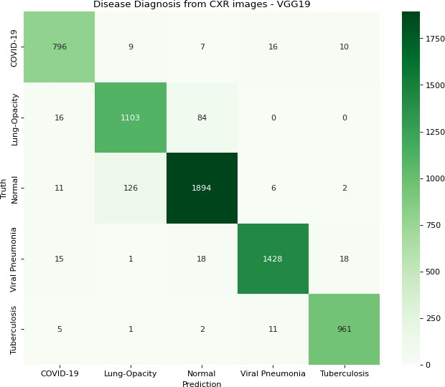
Testing and Validation of Solution
6,540-image test set · five-class evaluation
COMPLETED
Fixed test split of 6,540 images, same for all models
Accuracy, precision, recall, F1, ROC-AUC (ViT also top-2: 0.9365)
Confusion matrices and class-wise error analysis
Qualitative explainability review
LIMITATIONS
Single run, no statistical testing
No external-dataset validation
No clinician evaluation
VGG19 confusion matrix (source figure): Lung Opacity ↔ Normal is the main error.
RECOMMENDED (not yet done)
External validation, calibration, clinician review
11 / 13

Slide 12
Conclusion
Investigated
Five architectures for five-class chest-radiograph classification
Findings
VGG19 best (F1 0.945); ResNet50 0.937; Custom CNN 0.925 with 2.54 M params; ViT 0.786
Contribution
Documented preprocessing, imbalance-aware training, transparent reporting of discrepancies
Limitations
Single run, heterogeneous data, no external or clinical validation
Future scope
Multi-site data, external validation, calibration, hybrid CNN–ViT, clinician evaluation
This is a chest-image classification study, not a clinically validated diagnostic system. Reliable medical AI requires more than high accuracy.
12 / 13

Slide 13
Thank You
13 / 13

